Slide 1


BCS Framework – TableObjects ValidateManager & JavaScript
Part II – Structure
Spring/Summer, 2010
Notes:
1

Slide 2
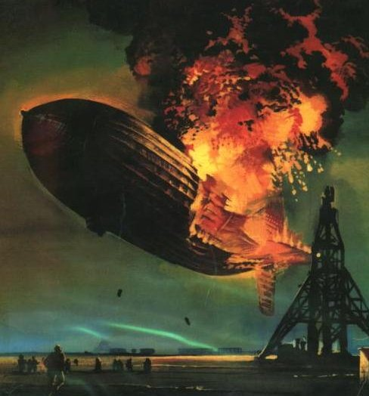
Hindenbug
A catastrophic, data-destroying, supplier-leakage kind of bug. Think Gillette, Kraft Flex, and a few others. Or Connection Pooling!

Slide 3
TableObjects – Creation
When the Java methods createTable or renderTable are called, all HTML related to the display and operation of the table are generated
The basic HTML structures
Sorting buttons in headers
Pagination code
Add/Delete mini-table
Download buttons
When the Java method generateJavaScript is called, all basic JavaScript VM code is automatically generated.
On some occasions, you might need to add a bit more.

Slide 4
TableObjects – Structure
Every TableObject table has a common structure.
Some tables have optional elements
All elements can be addressed and manipulated dynamically via VM methods
Address any part of the TableObjects with one of the following VM methods:
tbl.setTagProperty(property, value, element, subElmt)
tbl.setTagStyle(style, value, element, subElmt)
tbl.setTagHTML(position, HTML, element, subElmt)
position: append, prepend, replace, remove (or null)
tbl.getTags(element, subElmt) – Returns [array] of elements
[colName].setTdProperty(property, value) – Used in Actions
[colName].setTdStyle(style, value) – Used in Actions
[colName].getTd() – Used in Actions
What are the elements/sub-elements that can be addressed?

Slide 5
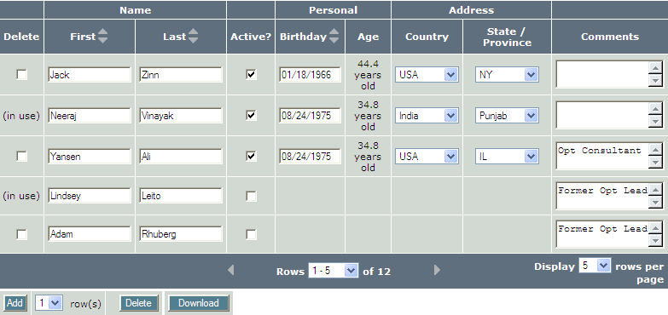
TableObjects/VM – Containers
container (<div>)
scrolling (<div>)
Use “container” to hide/show entire TableObject tbl.setTagStyle(“display", "none", "container") (or “block" to display)
The “scrolling” object is reserved for scrolling

Slide 6
TableObjects/VM – Structure: Table
Thead <thead>
table <table>
tbody <tbody>
tfoot <tfoot>
The tfoot object is only present if the table is paginated

Slide 7
TableObjects/VM – Structure: thead
(<th>) grpHeaders
(<th>) grpHeader, 0
(<th>) grpHeader, 3
(<tr>) grpHeaderRow
headerRow (<tr>)
header, "fName"
header, "age"
headers
(assumes colNames of "fName" and "age", as appropriate)

Slide 8
TableObjects/VM – Structure: tfoot
The tfoot object is only present if the table is paginated
<tr> pagination
tfoot <tfoot>
(This has limited use, but is included for completeness)

Slide 9
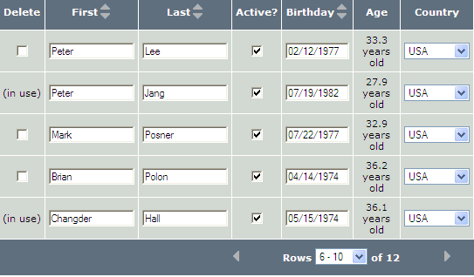
TableObjects/VM – Structure: tbody
(<td>) [fName], 7
(<td>) [active]
tbl.getStartRowNum() :6 is returned
(<tr>) row, 7
(<tr>) row, all
tbl.getRowCount() :5 is returned
tbl.getEndRowNum() :10 is returned
rowTd, 10 (<td>)
(assumes colNames of "fName" and "active", as appropriate)

Slide 10
TableObjects/VM – Structure: Add/Delete
delButton (<input button>)
addButton (<input button>)
addDelete <table>
addBtnCell (<td>)
delBtnCell (<td>)
addDDCell (<td>)
addDD (<select>)
download (<table>)

Slide 11

TableObjects – Structure: Alternate Text
altText, Row (<tr>)
altText, Col (<td>)

Slide 12
TableObjects – Structure in VM
Element | Sub-Element | Tag | Description
Container |  | div | Entire container div
Scrolling |  | div | Scrolling div, future usage
Table |  | table | Main data table (named table)
Thead |  | thead | thead object of main table
Tfoot |  | tfoot | tfoot object of main table
Tbody |  | tbody | tbody object (single) of main table
headerRow |  | tr | Header row
header | colName | th | Header row, specific column's th
headers |  | th * | All th tags in header row
grpHeaderRow |  | tr | Group-Header row
grpHeader | Index | th | 0-based index into Group-Headers
grpHeaders |  | th * | All th tags in group header row

Slide 13
TableObjects – Structure in VM
Element | Sub-Element | Tag | Description
Row | n | tr | tr tag where rowNum=n
Row | All | tr * | All tr tags in table
RowTd | n | td * | All td tags in row rowNum=n
[colName] | n | Td | Specific coordinate (col, row) of td tag
[colName] |  | td * | All td tags for that column, within tbody
Pagination |  | tr | Pagination row
altText | Col | td | td tag of Alt Text. "Col" is a keyword
altText | Row | tr | tr tag of Alt Text. "Row" is a keyword
NOTE:
While the "[colName], n" construct is very useful in some situations, this actually just refers to the <td> that surrounds a cell. It is often the case that using [colName].setTdStyle(), [colName].setTdProperty(), or [colName].getTd() is a more natural alternative.

Slide 14
TableObjects – Structure in VM
Element | Sub-Element | Tag | Description
Download |  | table | Table containing Download button
addDelete |  | table | Table containing Add/Delete buttons
addButton |  | input | Add Button
delButton |  | input | Delete Button
addDD |  | select | Add Dropdown
addBtnCell |  | td | td tag of Add button
addDDCell |  | td | td tag of Add dropdown
delBtnCell |  | td | td tag of Delete button
NOTES:
Italics Substitute actual value
Bold Always available. Otherwise result could be null or no action
* May return/operate on multiple objects
Except for colName, all keywords are case-insensitive

Slide 15
TableObjects/VM Stuctures – Take-Aways
All TableObjects have a common structure.
All (most?) elements can be addressed / manipulated via the VM environment
Properties and Styles can be directly changed via Table-methods setTagProperty() and setTagStyle()
Tags can be accessed for further manipulation via the Table-method getTags(). This always returns an array, even if only element is returned (or 0)
To replace, prepend, or append HTML to an element, use Table-method setTagHTML()
Note that all TableObject VM methods, except those that explicitly return values (e.g., getTags(), getRowCount(), getStartRowNum()) are chainable.
Typically use the Cell-based methods setTdProperty(), setTdStyle(), and getTd() when manipulating a single cell's surrounding <td>.

Slide 16
End of Part II Thank You
Next: Actions / Cell Methods – P1
© - All rights Reserved
16
CONFIDENTIAL
Notes:
16

